Slide 1
VFD Update
November 10, 2016
Phil A. Lowe, DVM
Beef Cattle compliance and examples

Slide 2
VFD Basics
Effective January 1, 2017
Must be written in context of a VALID VCRP
All Medically important feed grade antibiotics
  Tetracyclines
  Sulfas
  Tylosin
No Extra label use allowed
No unapproved combinations including generics
Must keep VFD’s for 2 years in manner submitted
VFD Expiration Maximum of 6 months

Slide 3
Water soluble antibiotics become Rx
Feed Mill must make a one time notification to FDA of intent to be distributors of VFD feeds
  This includes producers who produce own Type B or C feed on farm from a Type A product
Feed Mills must be licensed by FDA to sell Category II medicated feeds
Fly Control products not affected
Milk / Replacer considered feed

Slide 4
No feed efficiency/increased rate of gain labels for medically important antibiotics
  Does not apply to ionophores
Only applies to feed grade antibiotics
  Does not apply to injectable antibiotics

Slide 5
Feed Grade Classifications
Type I – Does not require a withholding at minimum feeding rate
Type II – Use requires a pre slaughter withholding
Class A – Raw product used to manufacture B & C feeds
          Does not require VFD to purchase
          MUST HAVE VFD TO FEED
Class B – Pre-mix or mineral combinations
Class C – Final mixed ration

Slide 6
What has to be included in a VFD ?
Veterinarian’s name, address, and telephone number
Client’s name, address, and phone number
Premises at which the animals in the VFD are located
Date of issuance
Expiration date of VFD
Name of the VFD drug(s)
Species and production class of animals to be fed VFD

Slide 7
Approximate number of animals to be fed the VFD feed by the expiration date
Indications for which the VFD is issued
Level of VFD drug in the feed in grams per ton and duration of use
Withdrawal time, special instructions and cautionary statements necessary for use of the drug
Numbers of reorders(refills) authorized, if permitted by the drug approval

Slide 8
Statement: “Use of feed containing this veterinary feed directive (VFD) drug in a manner other than as directed on the labeling (extralabel use), is not permitted.”
An affirmation of intent for combination VFD drugs
Veterinarian’s signature

Slide 9
Approved Combinations
Aueromycin/Bovatec
Decox/Rumensin/Tylan
MGA/Bovatec/Tylan
Rumensin/Tylan
MGA/Rumensin/Tylan
Rumensin/Pulmotil
Decox/Rumensin
MGA/Rumensin

Slide 10
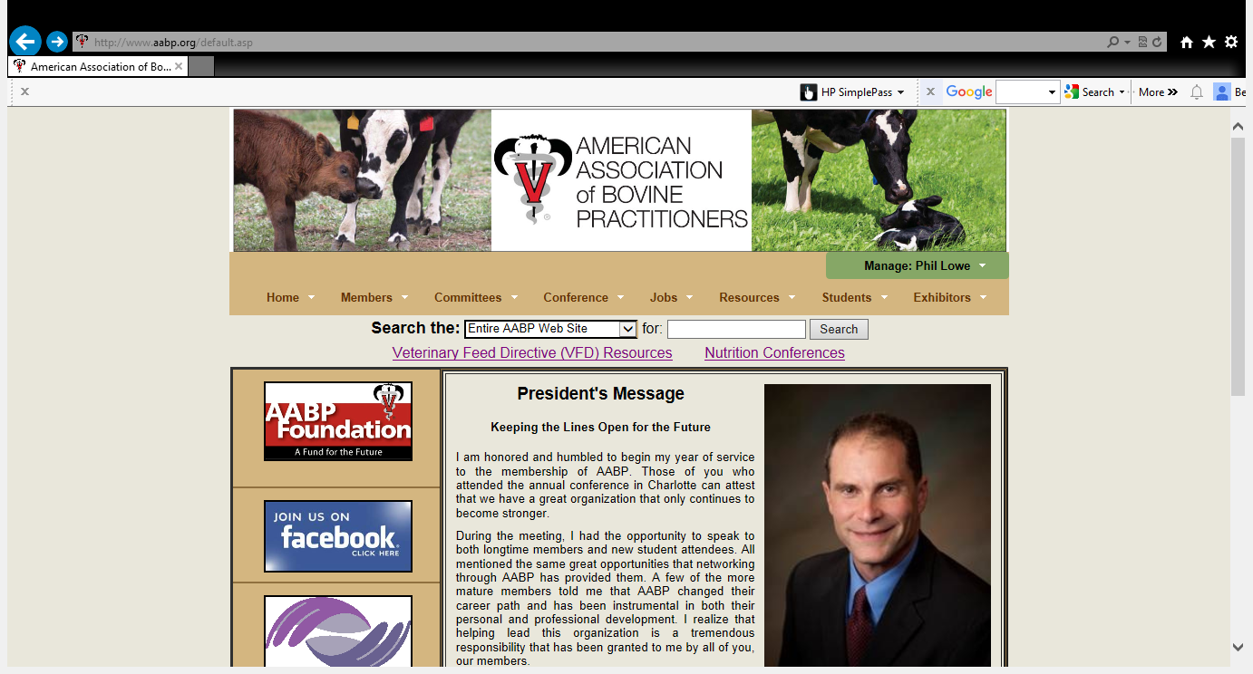

Slide 11
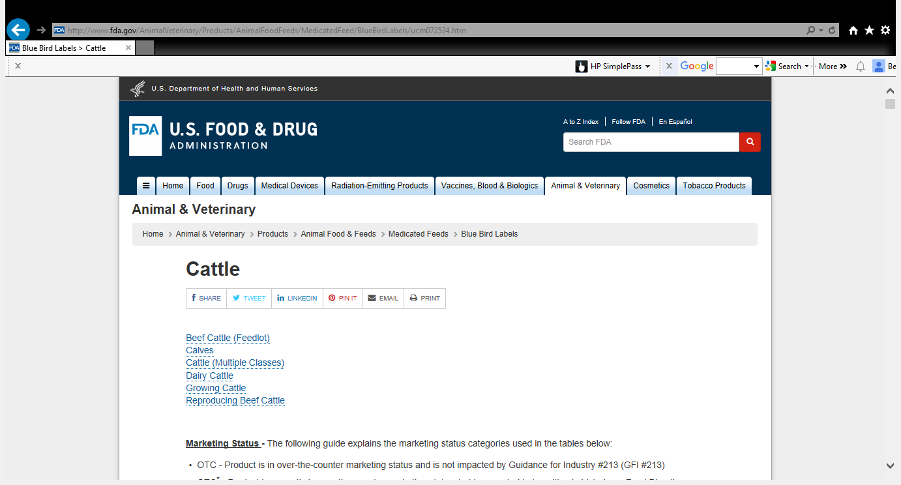

Slide 12
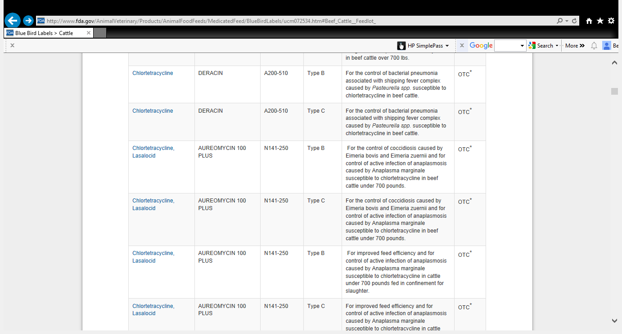

Slide 13

Download Compendium of Veterinary Products on your Apple/Android device
  Quick, easy and mobile access to all product labels
  Search in the Apple or Google play store

Slide 15
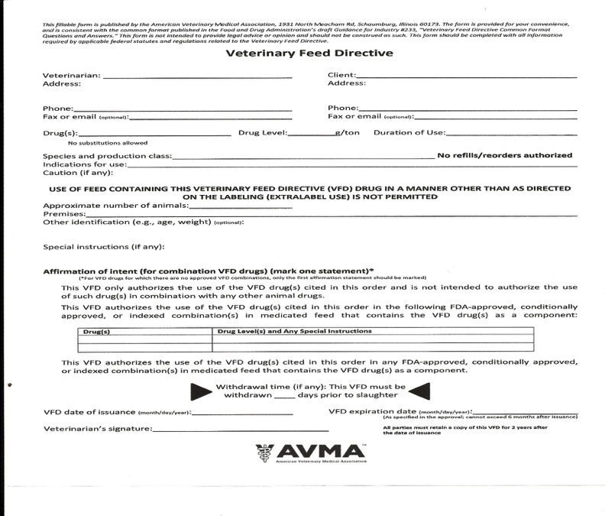

Slide 16
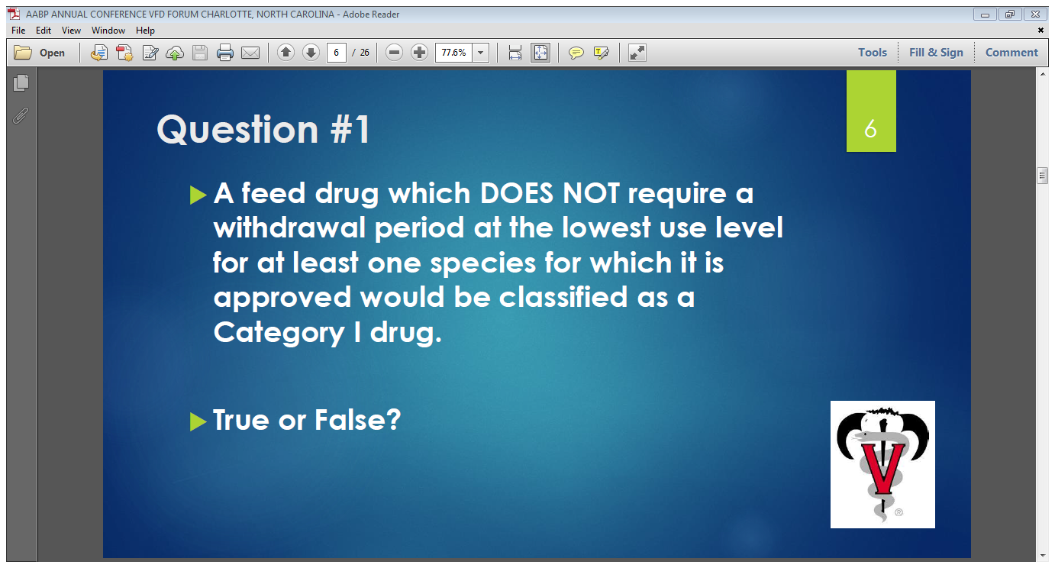

Slide 17
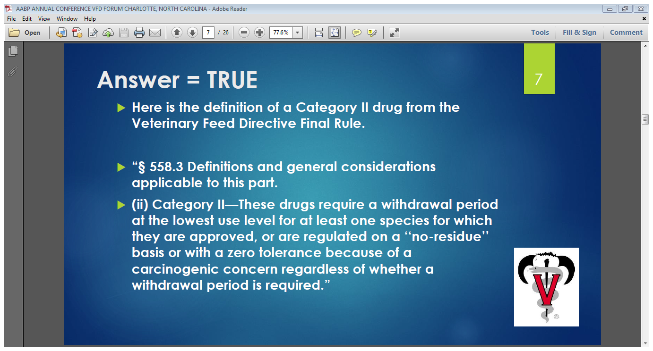

Slide 18
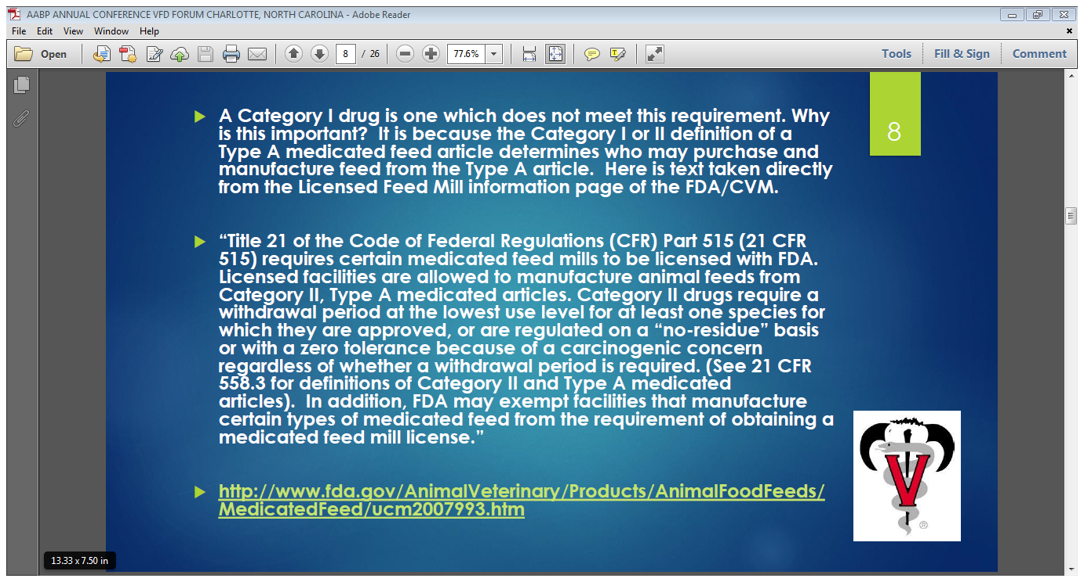

Slide 19
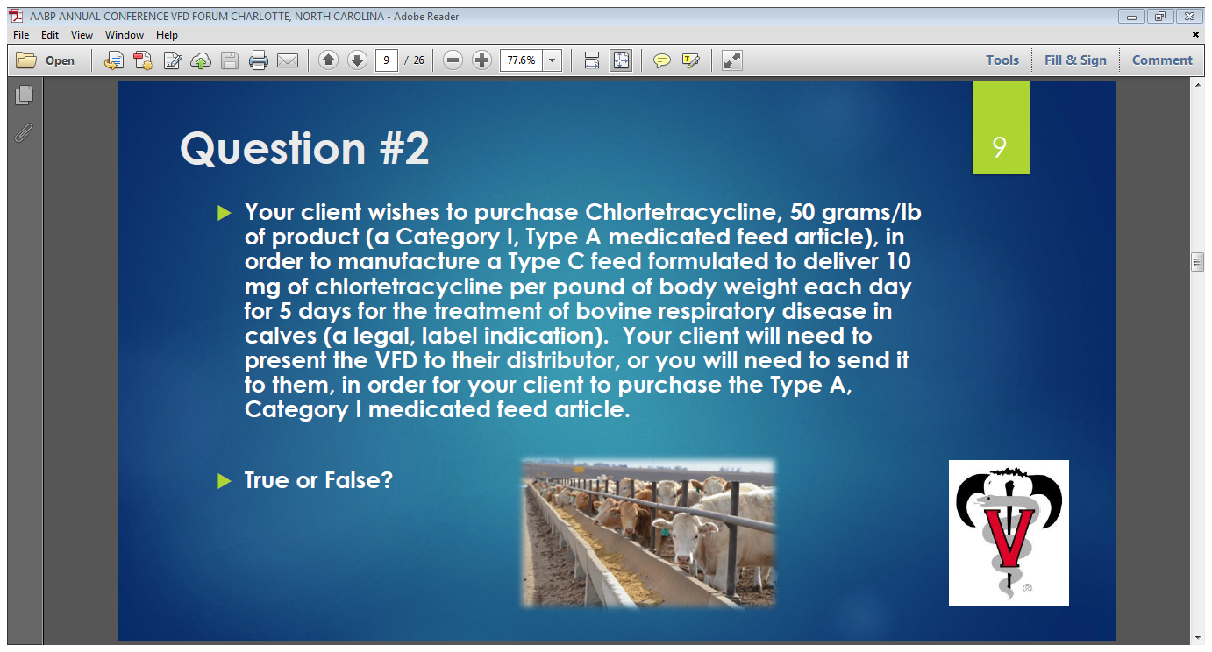

Slide 20
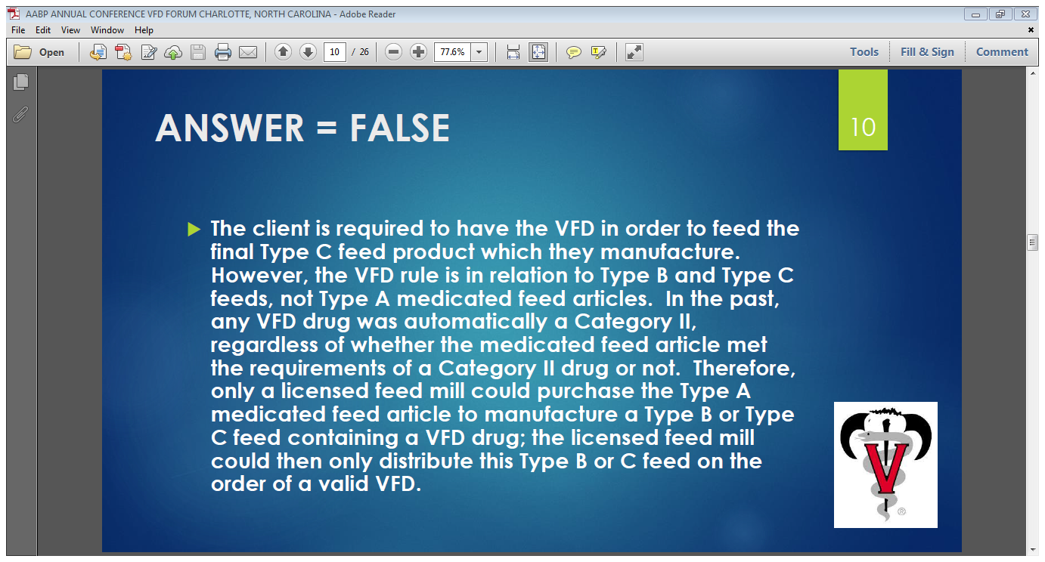

Slide 21
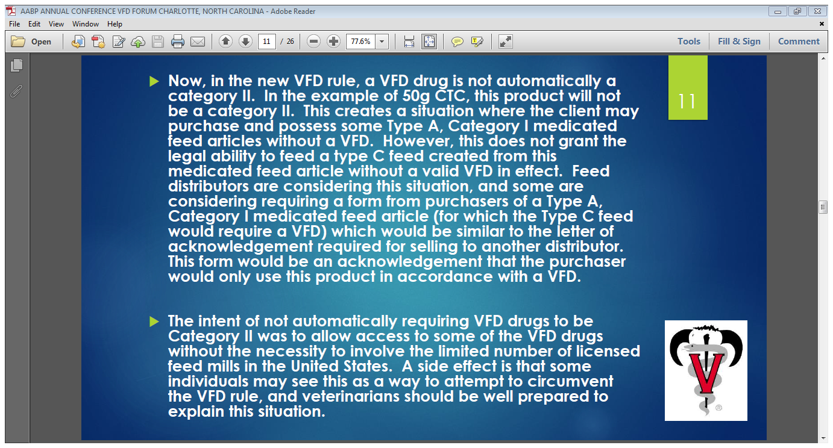

Slide 22
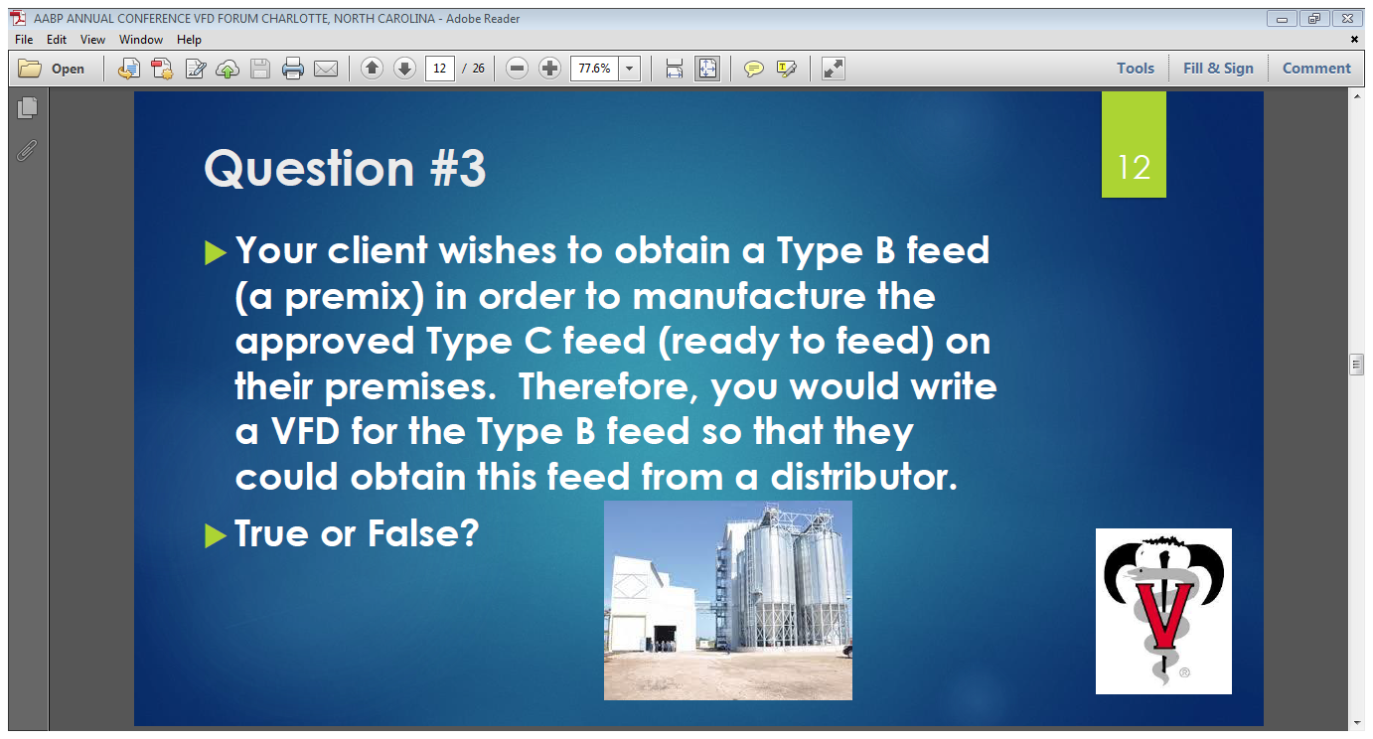

Slide 23
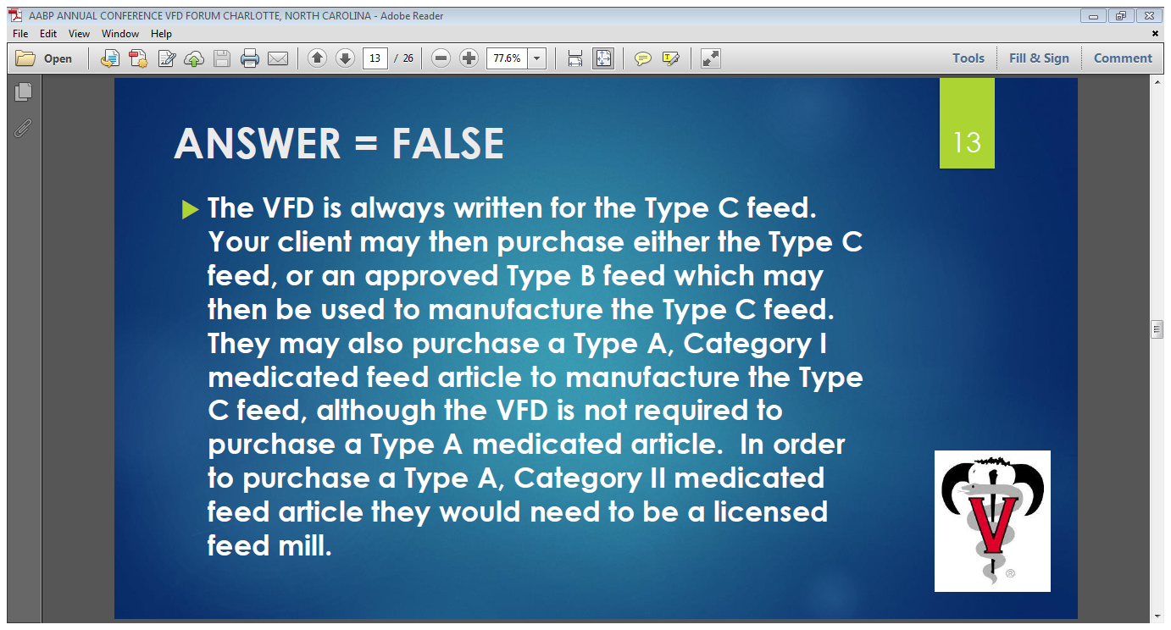

Slide 24
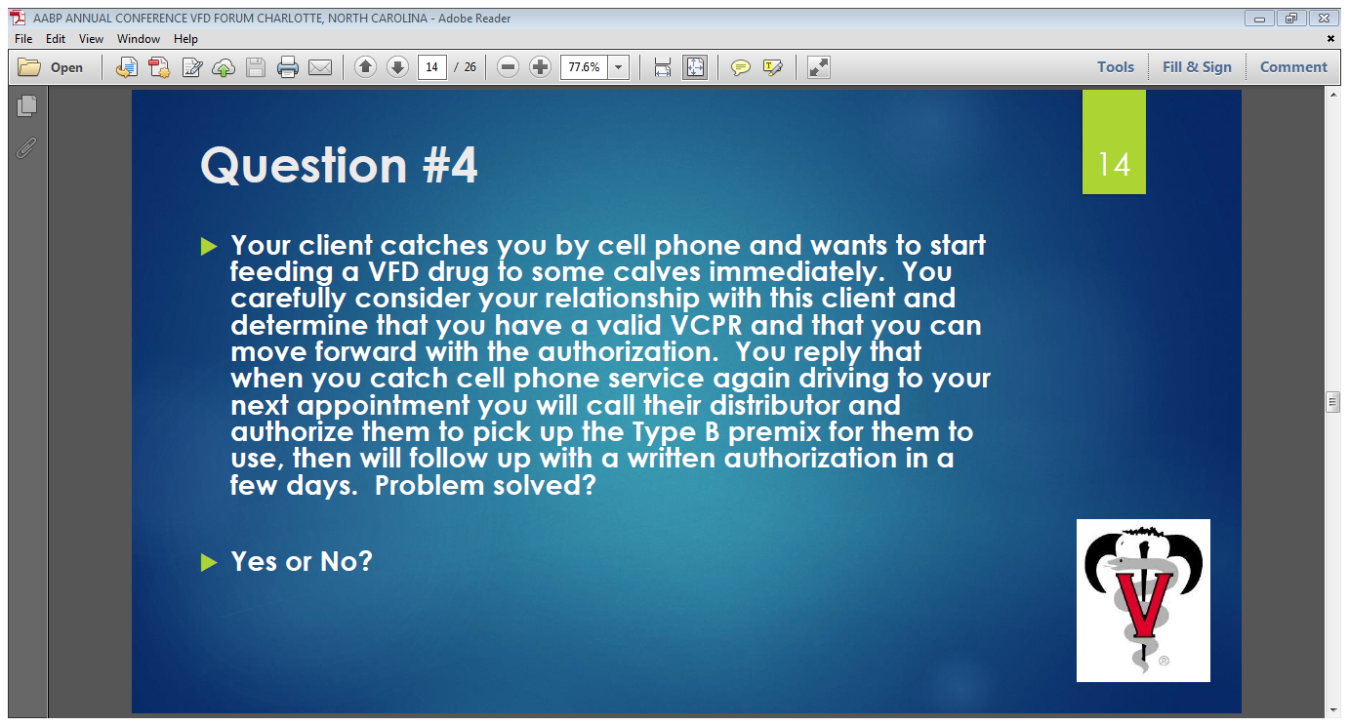

Slide 25
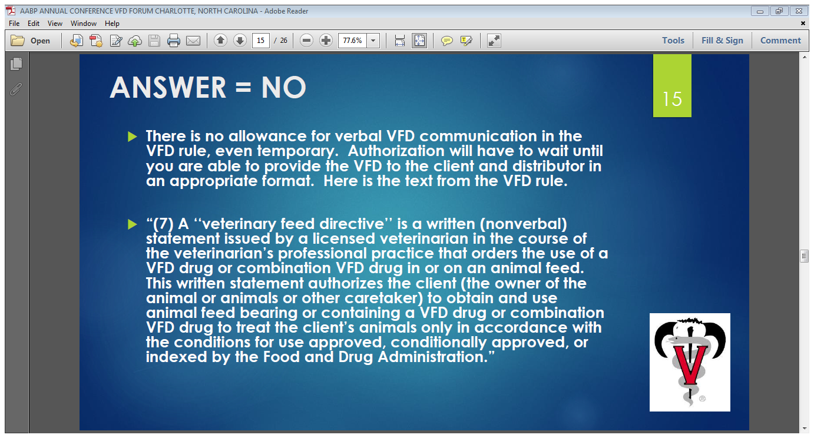

Slide 26
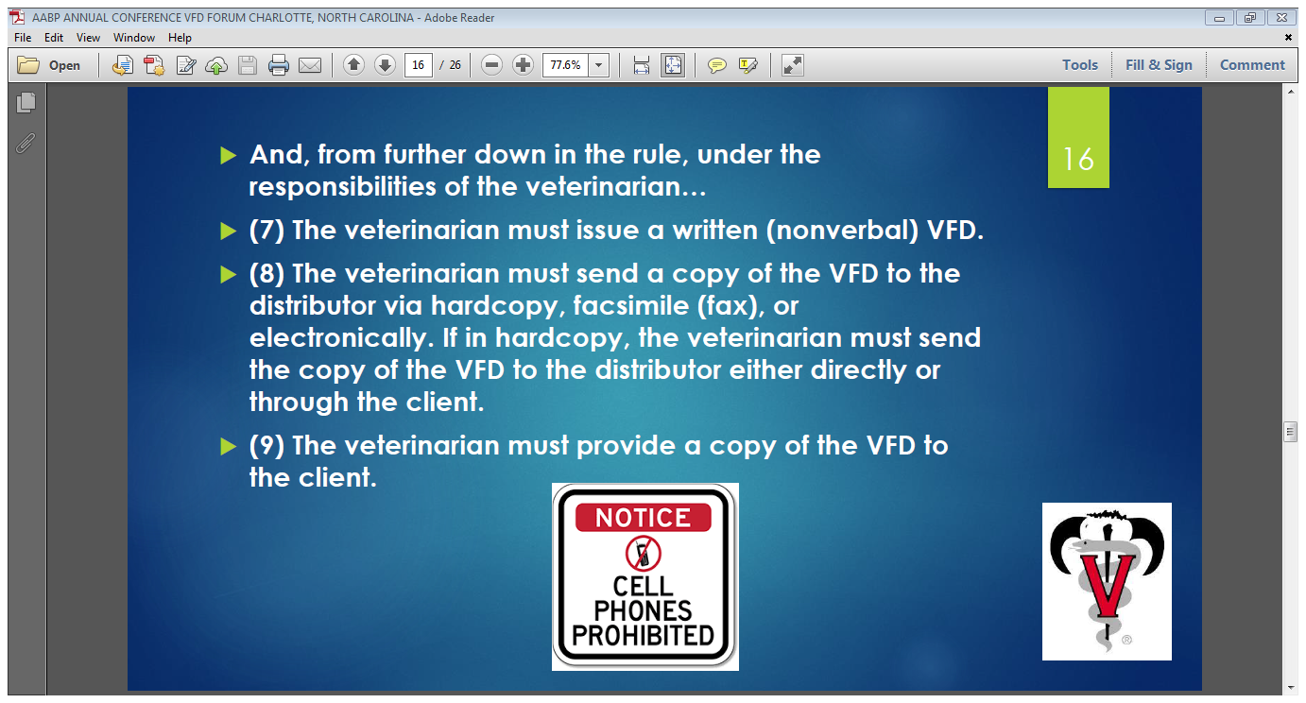

Slide 27
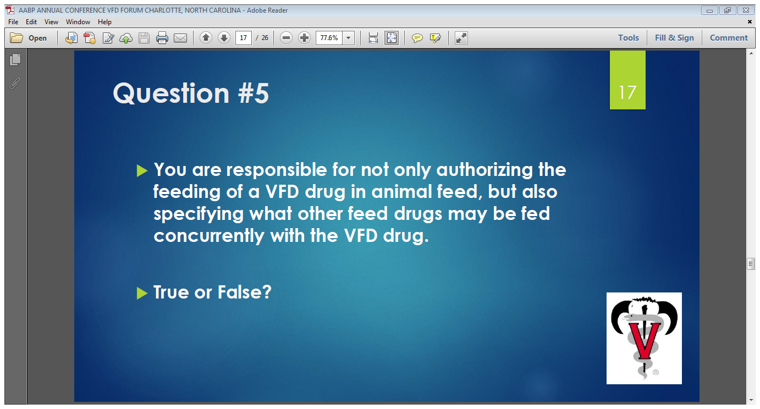

Slide 28
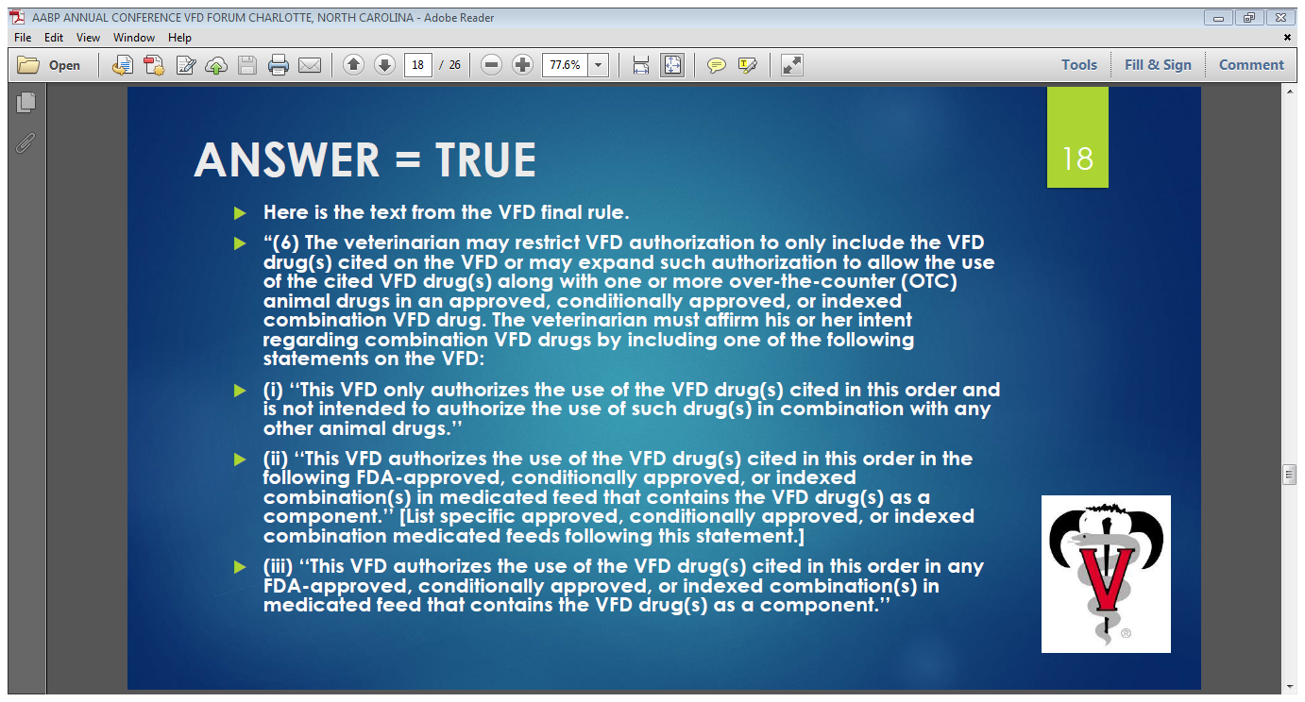

Slide 29
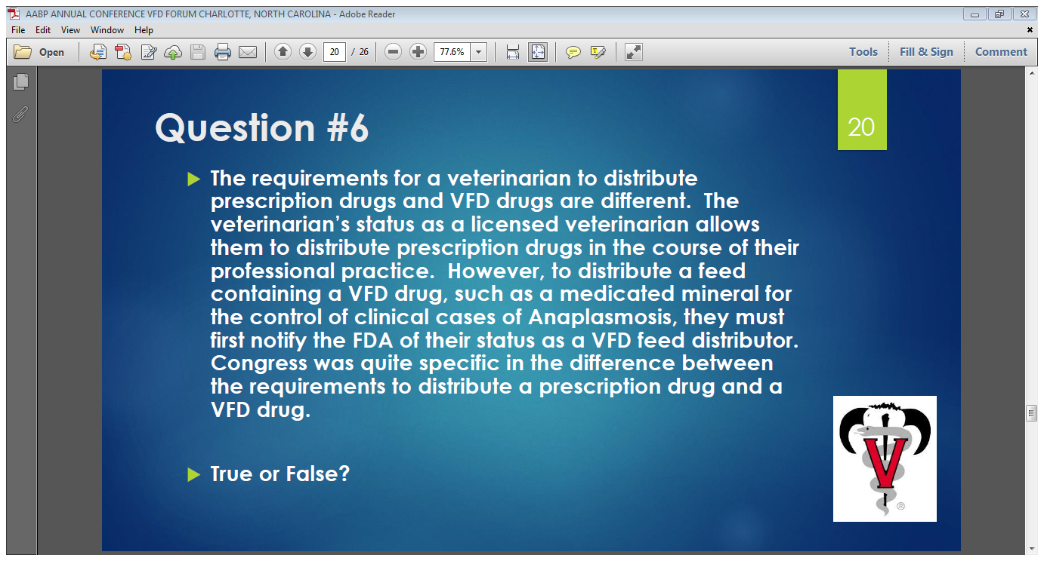

Slide 30
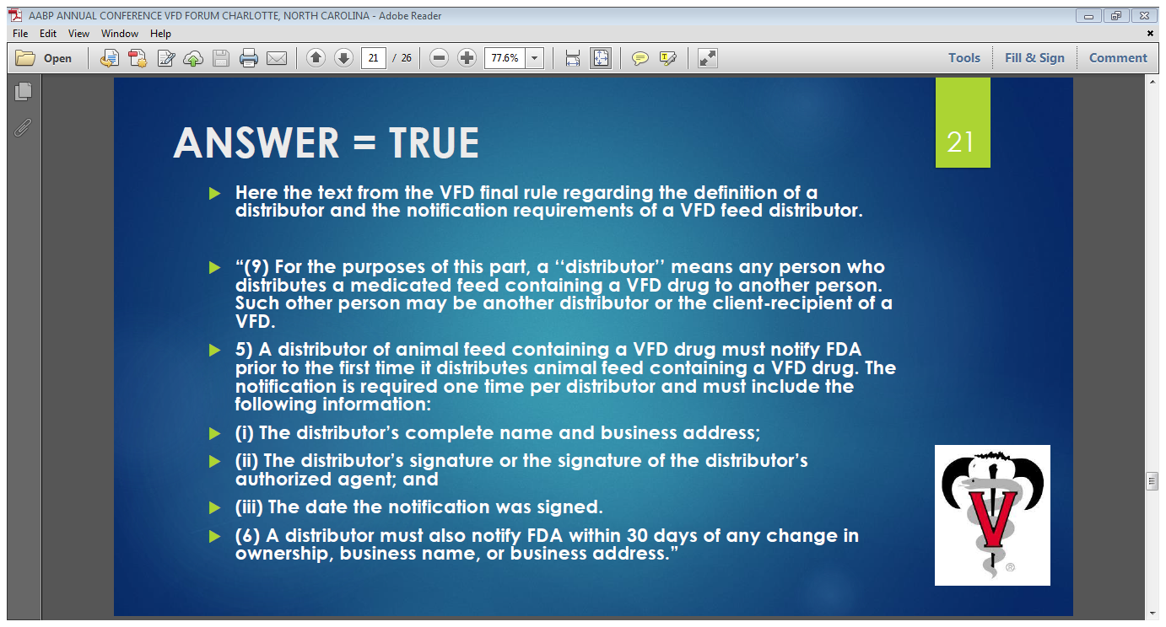

Slide 31
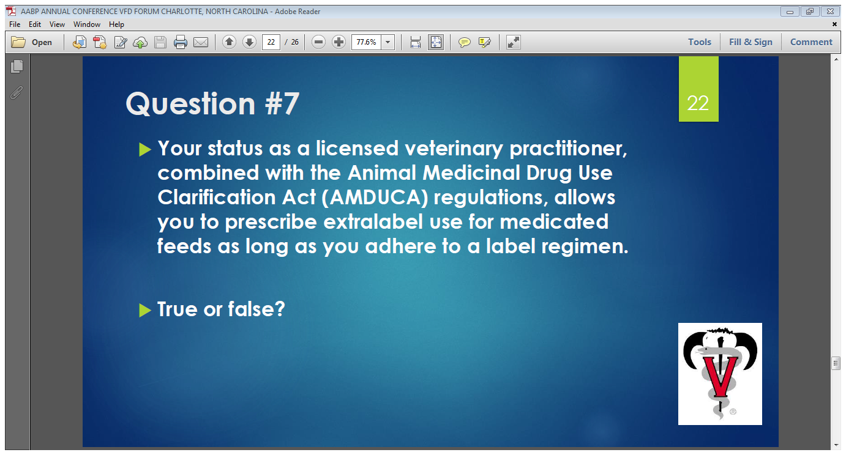

Slide 32
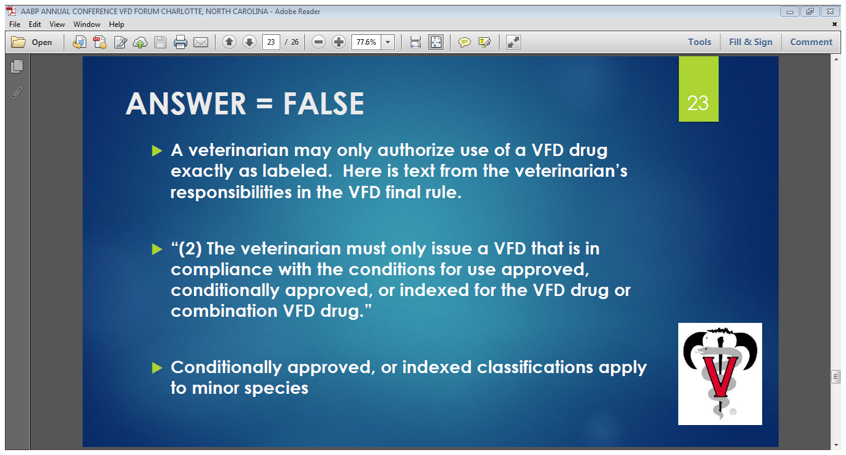

Slide 33
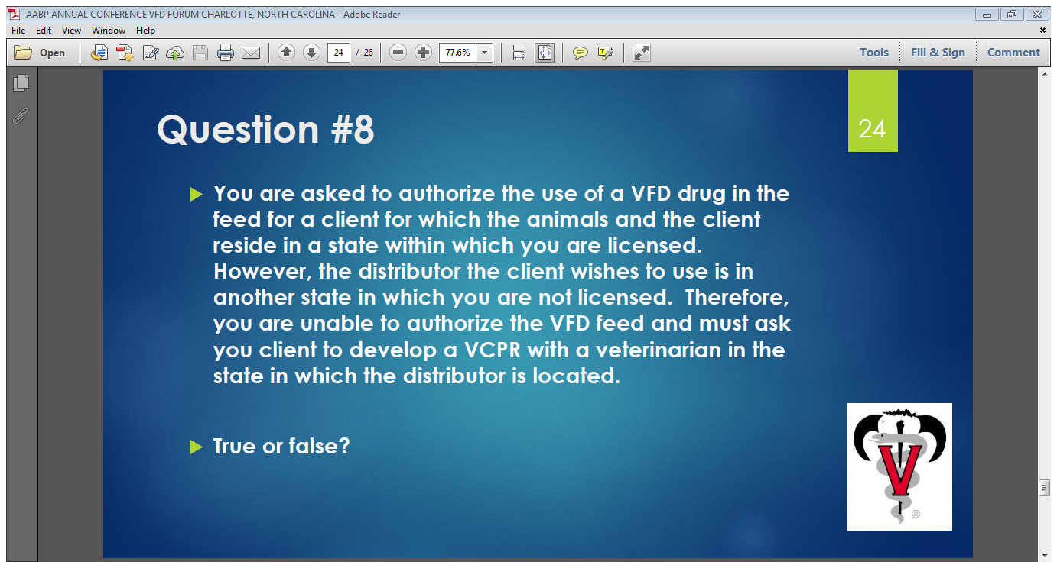

Slide 34
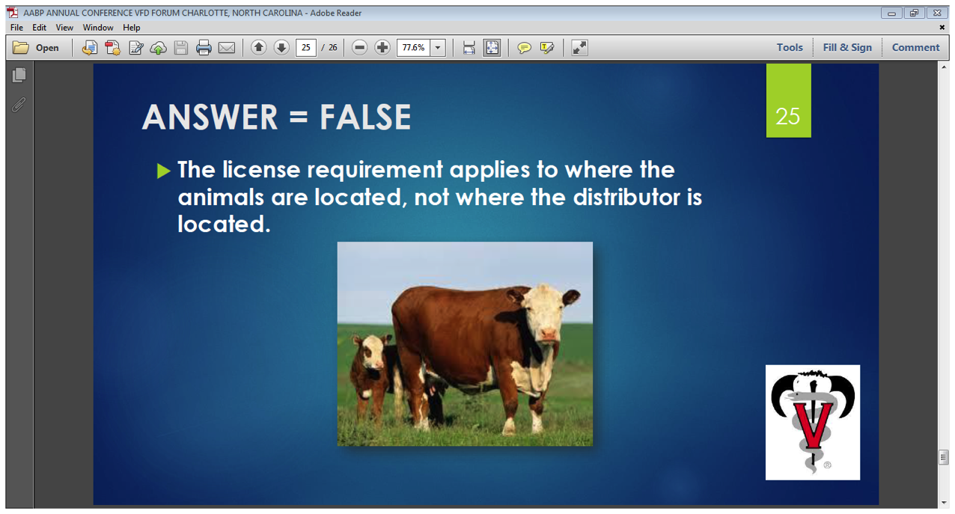

Slide 35
Case Example #1
A client has weaned 50-550# Angus calves
You are called out to necropsy a dead calf
You diagnose bacterial pneumonia based on necropsy
Several other calves appear sick and client request a VFD to feed chlortetracycline to remaining calves
They want to purchase a Type B premix containing CTC and feed to remaining calves at a rate of 5#/head/day

Slide 36
Product and Label Indications
Aureomycin 100 Granular
Label indication for treatment of bacterial pneumonia at 10 mg / lb. BW continuously for 5 days

Slide 37
Example #1 Math
Dose= 10 mg/lb. * 550 lb. BW= 5,500 mg per calf per day
5,500 mg CTC = 5.5 gr CTC per calf per day
Consuming 5# medicated feed per day
5.5 gr / 5# per day = 1.1 gr / pound of feed
1.1 gr / lb. * 2000lb/ton = 2,200 gr / ton of CTC

Slide 38
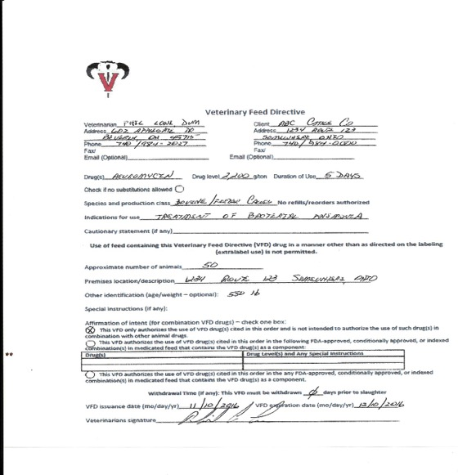
Sample VFD

Slide 39
Case Example #2
A neighbor of the client in example #1 has the same scenario however they have their calves split into 2 pens of 25 each and is only have problems in one pen
They would like to feed CTC to only the pen with sick calves but would like to repeat treatment in 2 weeks
They want a VFD written for the total 50 calves but they want to feed all to one pen and repeat in 2 weeks

Slide 40
Example #2
A separate VFD must be issued for each duration of therapy
Avoid the use of the word “refill”, as there are currently no products labeled for refills
When the VFD expires a new VFD must be issued for a second round of therapy under a VCPR
Put the correct estimate of the number of calves to be fed and the duration of therapy
The VFD for this example would look like the one in example #1 except for 25 calves

Slide 41
Example #3
A client with 50 cows on pasture calls and has treated 5 cows in the last week for foot rot with injectable oxytetracycline and all responded to therapy.
He now has 2 more cases and has talked to his nutritionist who has advised him to feed CTC in his salt/mineral mix at a rate of 350mg/hd./day to reduce new cases.
He calls for a VFD so he can feed the CTC for the next 30 days till the weather dries up.

Slide 42
Example #3
NO VFD CAN BE WRITTEN AS THERE ARE NO PRODUCTS APPROVED FOR TREATMENT OR PREVENTION OF FOOT ROT AND THERE IS NO EXTRA LABEL USE OF FEED GRADE ANTIBIOTICS ALLOWED

Slide 43
Example #4
A client with 50 cows has lost 2 cows in the last week
You perform a necropsy on a dead cow and diagnose Anaplasmosis
The client asks about feeding CTC in his mineral mix to reduce any new cases
Cows consume 4 oz of mineral mix per head per day
Cows average 1200 # BW

Slide 44
Example # 4 Products and Indications
Aureomycin 90 Grannular
Species: Beef Cattle
Indications: Anaplasmosis control/prevention
Dose: Cattle > 700 lb- 0.5mg/lb. BW daily

Slide 45
Math Example #4
0.5mg/ lb * 1200 lbs = 600 mg
Consume 4 oz mineral mix per head per day
Need concentration of 150mg/oz
150mg * 16 oz/lb= 2400 mg/lb
2400 mg/lb = 2.4 gr./lb
2.4 gr/ lb * 2000 lb/ton = 4800 gr/ ton

Slide 46
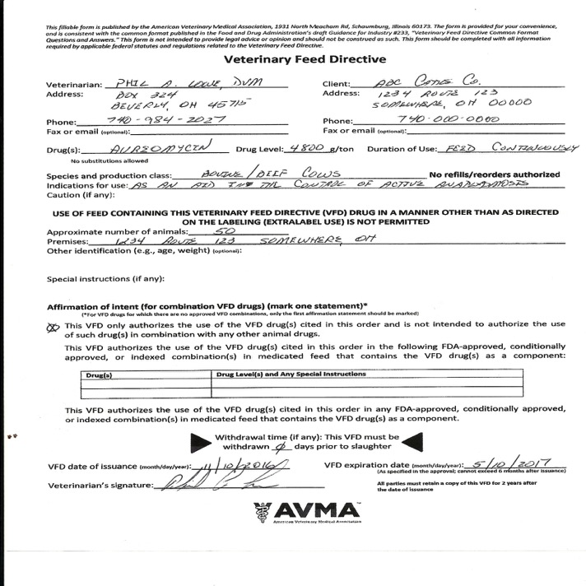

Slide 47
Example # 5
A feedlot client wants to feed monensin for feed efficiency and tylosin for liver abscess prevention
They will have 200 head on feed for a 180 day finishing period

Slide 48
Example # 5 Products
Tylan 100
  Use: reduction of liver abscess incidence
  Dose: 8-10 gr/ton of feed
Rumensin 90
  Use: feed efficiency improvement in beef cattle fed in confinement for slaughter
  Dose: 5-40gr/ton of complete feed continuously fed during finishing period

Slide 49
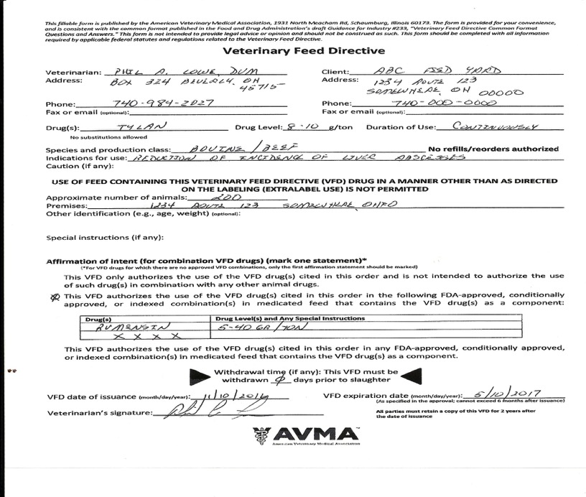

Slide 50
Example # 6
A local hoof trimmer asks for a prescription for Oxytetracyclaine soluble powder for use in the topical treatment of hairy warts under a foot wrap
Some of his customers are your clients and some are not

Slide 51
Example # 6
Water soluble products are now prescription only
Under AMDUCA you are allowed ELDU
Must be scripted under a VCPR

Slide 52
Example # 6
Inform hoof trimmer that you can not script product to him as you can only script to farms you have a VCPR with.
Script OTC powder directly to the clients that you have a VCPR with
Include written protocols for OTC soluble powder topical use for digital dermatitis treatment

Slide 53
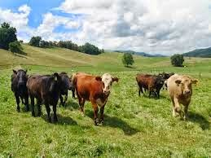
Thank You

