Slide 1


Veterinary Feed Directive
Compliance Workshop
Bill Minton DVM.
Four Star Veterinary Service LLC.
November 10, 2016

Slide 2
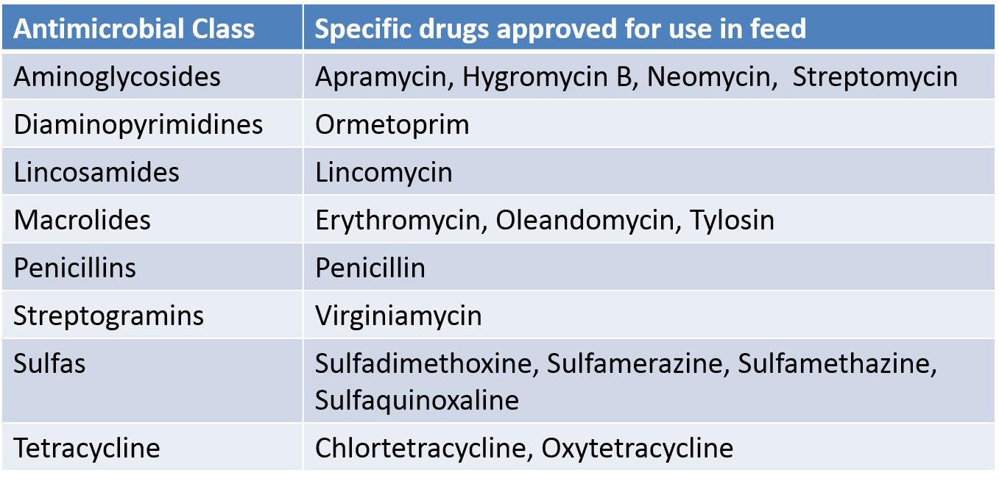
Medically Important
  Not Medically Important:
    Ionophores (monensin, lasalocid, narasin,etc. )
    Bacitracin (BMD, bacitracin zinc)
    Bambermycins
    Carbadox
    Tiamulin

Slide 3
Requirements for the Veterinarian:
Licensed in the State the animals reside
Develop a VCPR (Veterinarian – Client – Patient Relationship)
Diagnosing the need and determining the VFD medication necessary
Review the current medication uses with client to verify they conform to VFD label claims
Provide a copy of the VFD to the Client and and/or Feed distributor
Maintain a VFD record for at least 2 years from date of issuance

Slide 4
Requirements for the Veterinarian:
Issuing a VFD:
Only by a Licensed Vet
Have a Valid Veterinarian - Client – Patient Relationship (VCPR) as defined by the State requirements
In States lacking appropriate VCPR requirements for VFD’s; then must be consistent with Federal VCPR standard, as defined in 21 CFR 530.3 (i).
Ohio requires to maintain a valid VCPR every 6 months
No ELDU (Extra Label Drug Use) is permitted for feed!

Slide 5
What is a VCPR?
(1) A veterinarian has assumed the responsibility for making medical judgments regarding the health of (an) animal(s) and the need for medical treatment, and the client (the owner of the animal or animals or other caretaker) has agreed to follow the instructions of the veterinarian;
(2) There is sufficient knowledge of the animal(s) by the veterinarian to initiate at least a general or preliminary diagnosis of the medical condition of the animal(s); and
(3) The practicing veterinarian is readily available for followup in case of adverse reactions or failure of the regimen of therapy. Such a relationship can exist only when the veterinarian has recently seen and is personally acquainted with the keeping and care of the animal(s) by virtue of examination of the animal(s), and/or by medically appropriate and timely visits to the premises where the animal(s) are kept.
(4) Maintaining a valid VCPR varies state by state.

Slide 6
Requirements for the Producer:
Changes in VFD regulations begin January 1st, 2017
Provide best estimate of “number of animals“
Provide a copy of VFD to Feed Distributor or Mill if veterinarian does not
Maintain a copy of VFD for 2 years
Plan adequate time for allowing the origination & delivering of the VFD before medicated feed is needed

Slide 7
Requirements for the Distributor:
Understanding of medications affected; “medically important” vs. “non-medically important”
Ensure the VFD is filled out completely & correctly
Complies with medicated feed label & approvals
Amount of feed to be used is calculated reasonably
Maintain a copy of VFD for 2 years.

Slide 8



Developing a VFD
Written
  Pharmaceutical forms
  Custom
  Vet must keep the original signed paper copy
  Send out via email, fax or mail
Electronic
  GlobalVetLINK
  RxExpress
  Pharmaceutical company resources
    Elanco, Phibro, Zoetis
    Visit the Websites

Slide 9
Required Items on a VFD
VFD - 21 CFR 558.6(b)(3) requires the following information to be fully and accurately included on the VFD order:
  Veterinarian name, address, and telephone number;
  Client’s name, business or home address, and telephone number;
  Premises at which the animals specified in the VFD are located;
  Date of VFD issuance;
  Expiration date of the VFD;
  Name of the VFD drug(s);
  Species and production class of animals to be fed the VFD feed;
  Approximate number of animals to be fed the VFD feed by the expiration date of the VFD;
  Indication for which the VFD is issued;
  Level of VFD drug in the feed and duration of use;
  Withdrawal time, special instructions, and cautionary statements necessary for use of the drug in conformance with the approval;
  Number of reorders (refills) authorized, if permitted by the drug approval, conditional approval, or index listing;
  Statement: “Use of feed containing this veterinary feed directive (VFD) drug in a manner other than as directed on the labeling (extralabel use), is not permitted”;
  Affirmation of intent for combination VFD drugs as described in 21 CFR 558.6(b)(6); and
  Veterinarian’s electronic or written signature.
  Additional non-binding recommendations the veterinarian may make at their discretion
    More specific identification of the animals
    More specific description of the animal location – by pen, site, barn, bulk bin, stall
    Approximate age range of the animals
    Approximate weight range of the animals
    Other information deemed appropriate for identification of the animal(s)

Slide 10
VFD Records:
  VFD must have an expiration date which may be no more than 6 months after issue. Animals must not be fed the VFD feed after the expiration date of the VFD.
  Refills/Reorders associated with the VFD are only permitted if specifically permitted in the approved conditions of the particular VFD drug
  Location of the animals must be stated on the VFD.
  VFD requirement for approximate # of animals in the final rule specifies how the approximate # of animals should be determined
  Feed manufacturers may use either the original or generic approved as the equivalent unless the VFD states otherwise

Slide 11
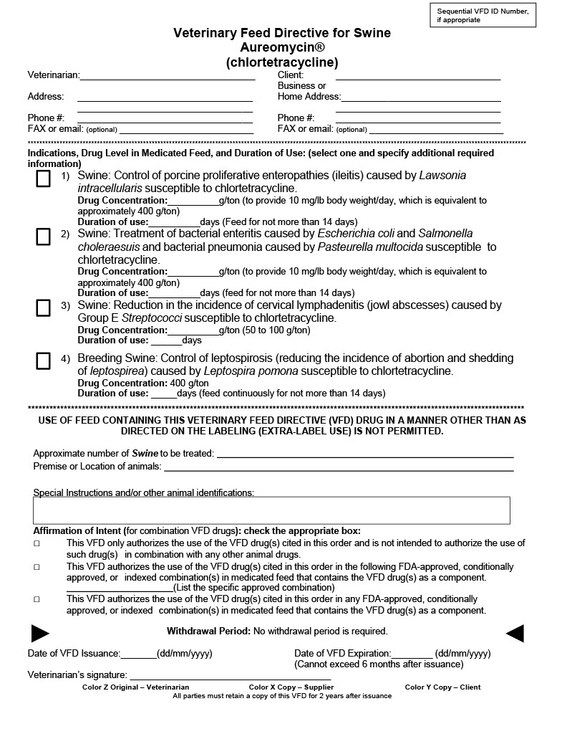

Slide 12
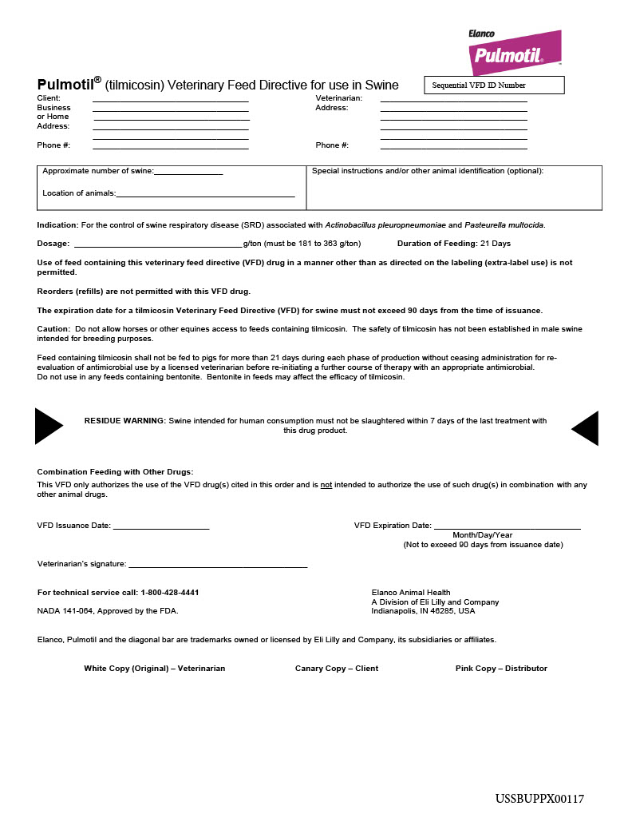

Slide 13
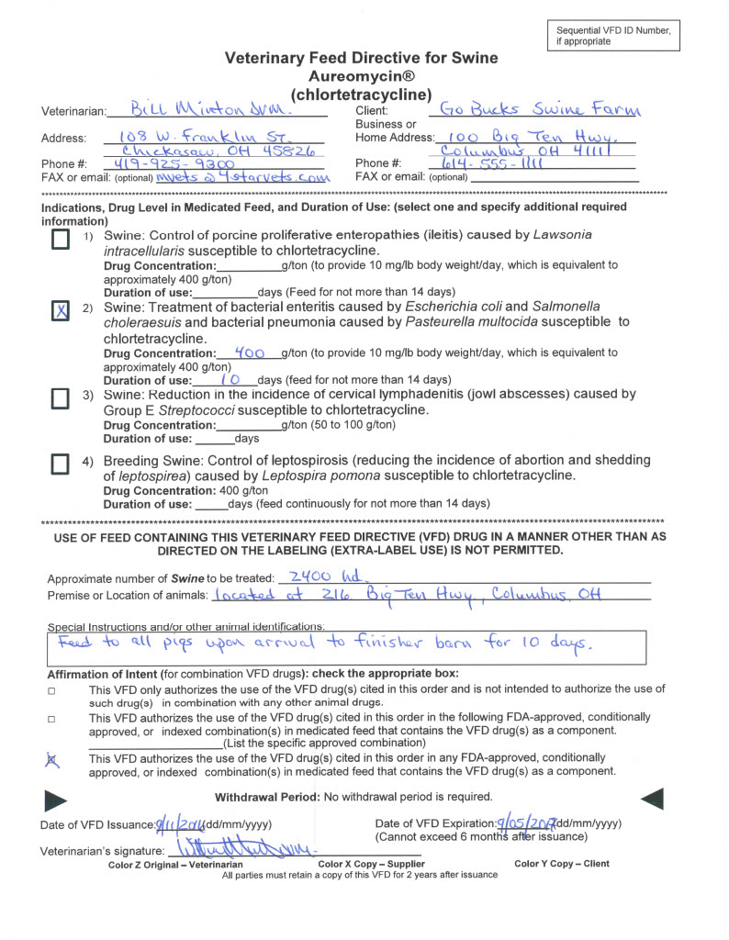

Slide 14
VFD Format - Electronic
FeedLINK Electronic VFD
  Vet creates VFD in secure account
  GVL SmartEngine Technology™ verifies accuracy and completeness
  Vet signs digitally, maintains as original copy
  Sends digitally to distributor
  Distributor accesses VFD in secure account, or receives via email

Slide 15
Electronic Benefits
Retains pre-existing Names / Addresses
Streamlines communication
Reduces or eliminates paper
Assists with compliance
Stores VFDs electronically
Streamlines workflow (integrates with current software)

Slide 16


FeedLINK Communication
Veterinarian
Producer
Feed Distributor

Slide 17
FeedLINK Benefits – Veterinarian
User-friendly, intuitive, and compliant system
VFD automatically available to feed distributor and producer
Meets 2 year record retention requirements
Maintains non-VFD feed-grade antibiotic records
Onboarding and training for all users
FeedLINK Benefits – Producer
  Access and store VFDs
  Coming soon – Request VFD

Slide 18
FeedLINK Benefits – Feed Distributor
Search, sort, and view current VFDs
Add shipment information
Store and retrieve VFDs
Claim VFDs
Store LOAs – (Letter Of Acknowledgement)
Coming soon – 2-way communication between feed distributor and vet
Webinars for Feed Distributors – “VFD News & Updates”
  Visit GVL Website

Slide 19
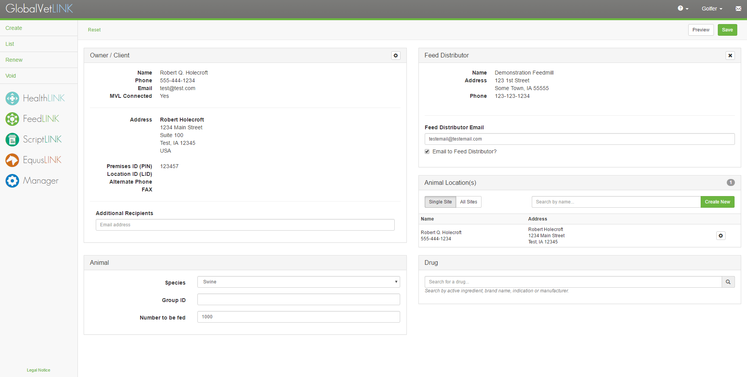
Creating a VFD - Pulmotil

Slide 20
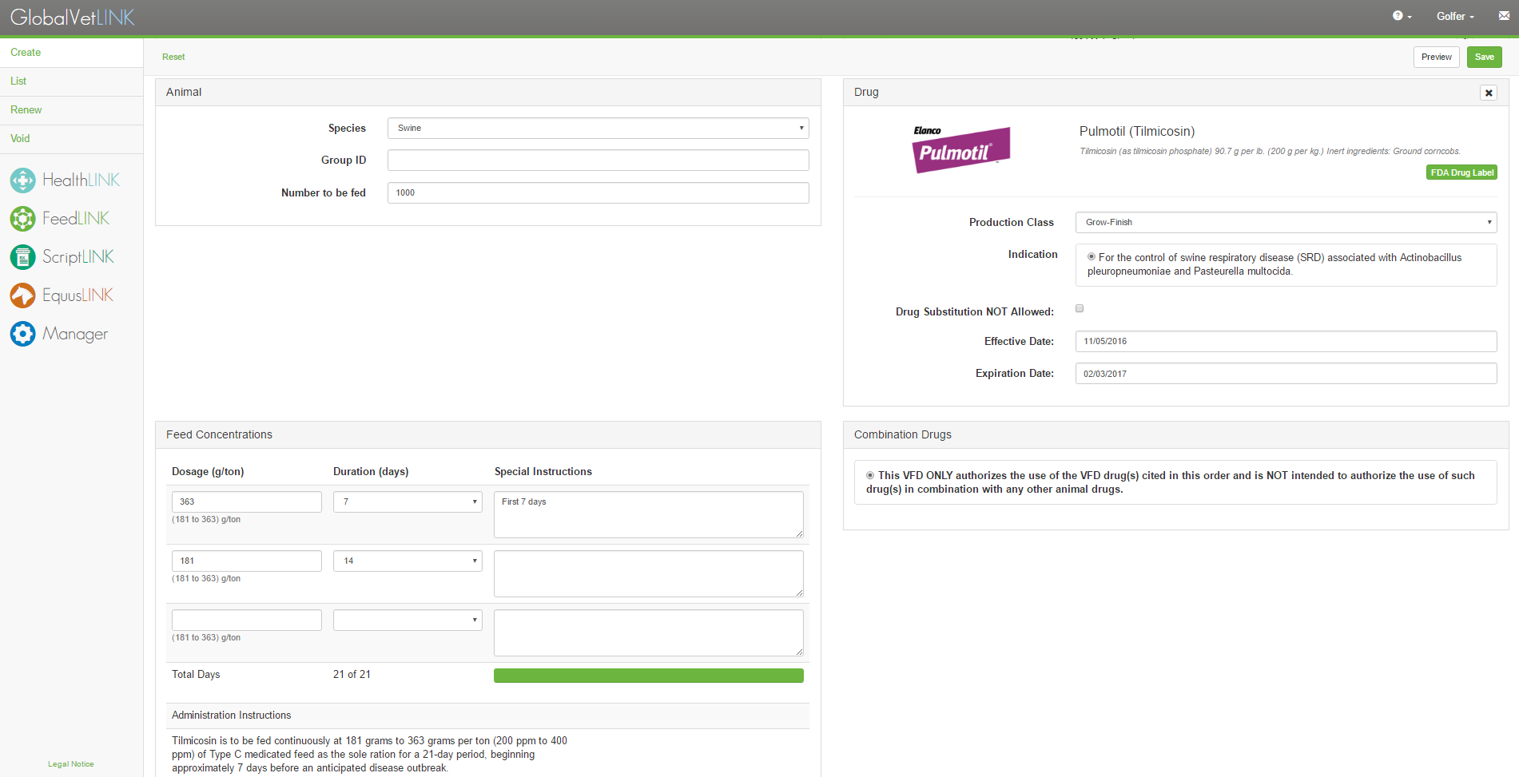
Only Label Options Available

Slide 21
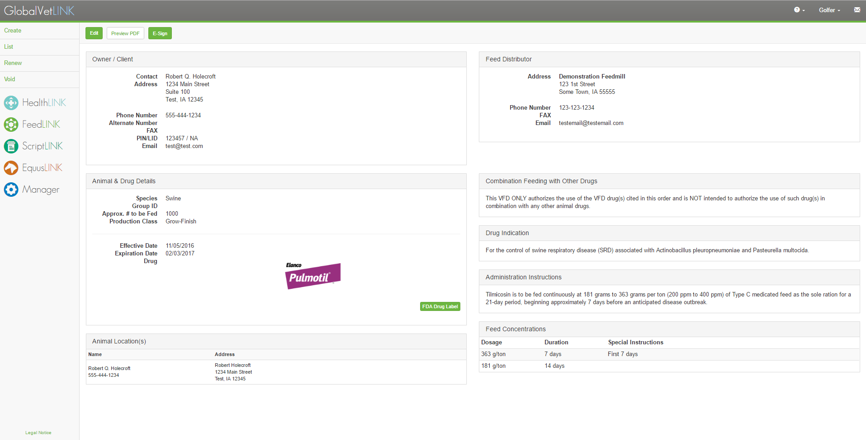
Preview VFD

Slide 22
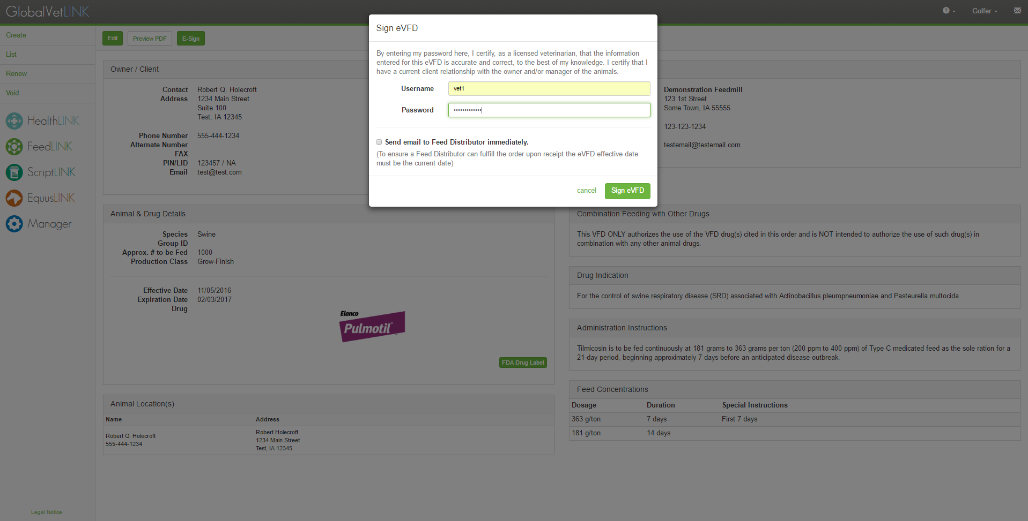
Sign VFD

Slide 23
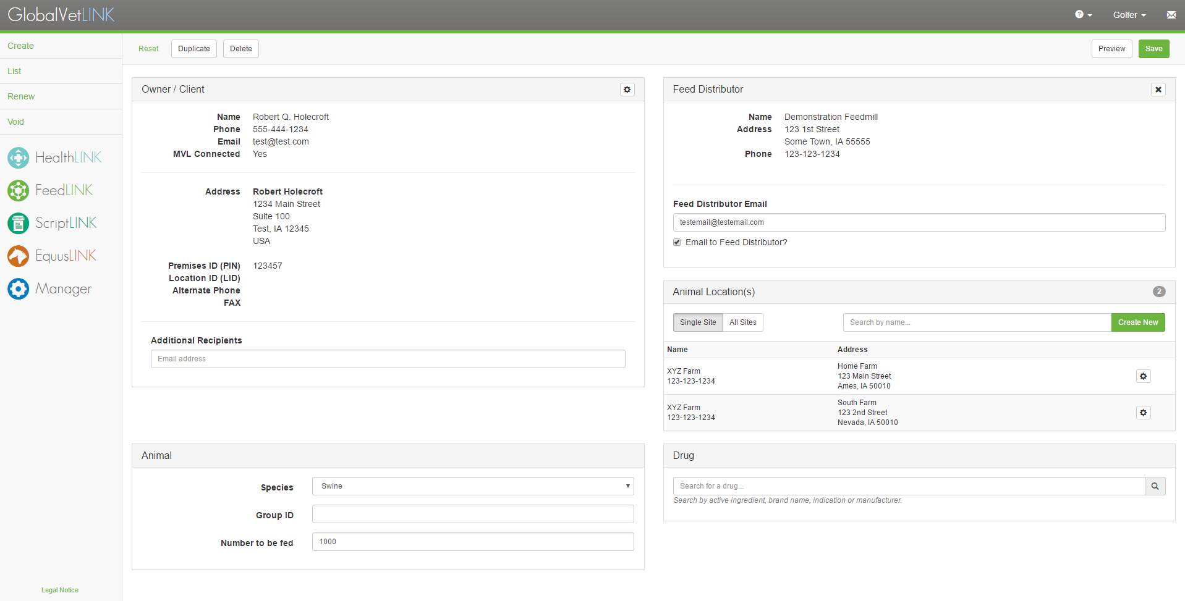
Creating a VFD – CTC + Denagard

Slide 24
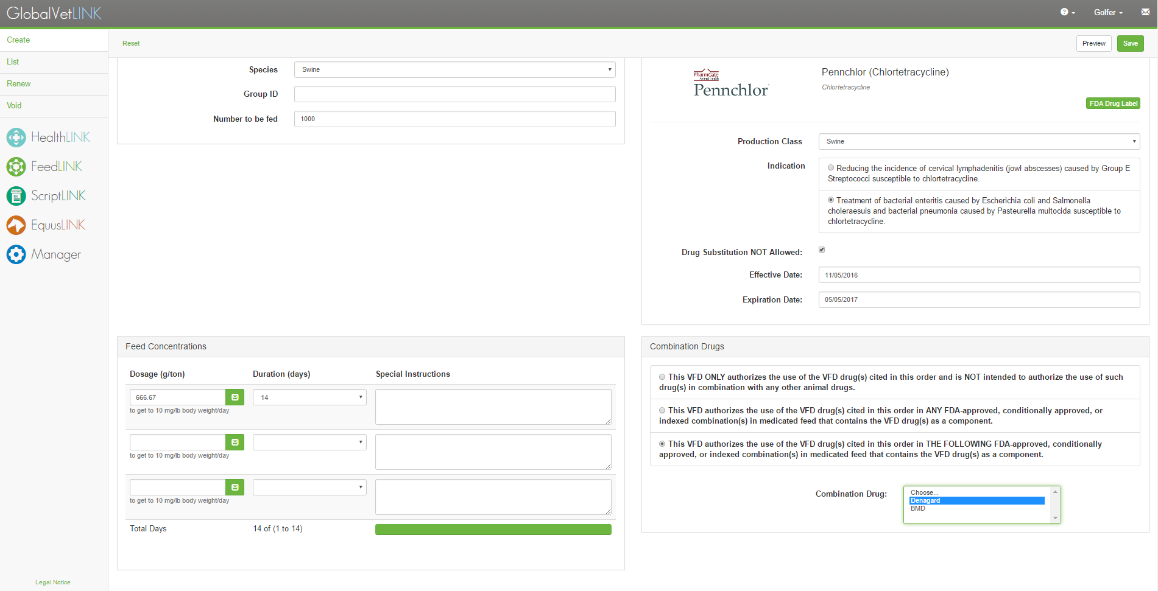
Only Label Options Available

Slide 25
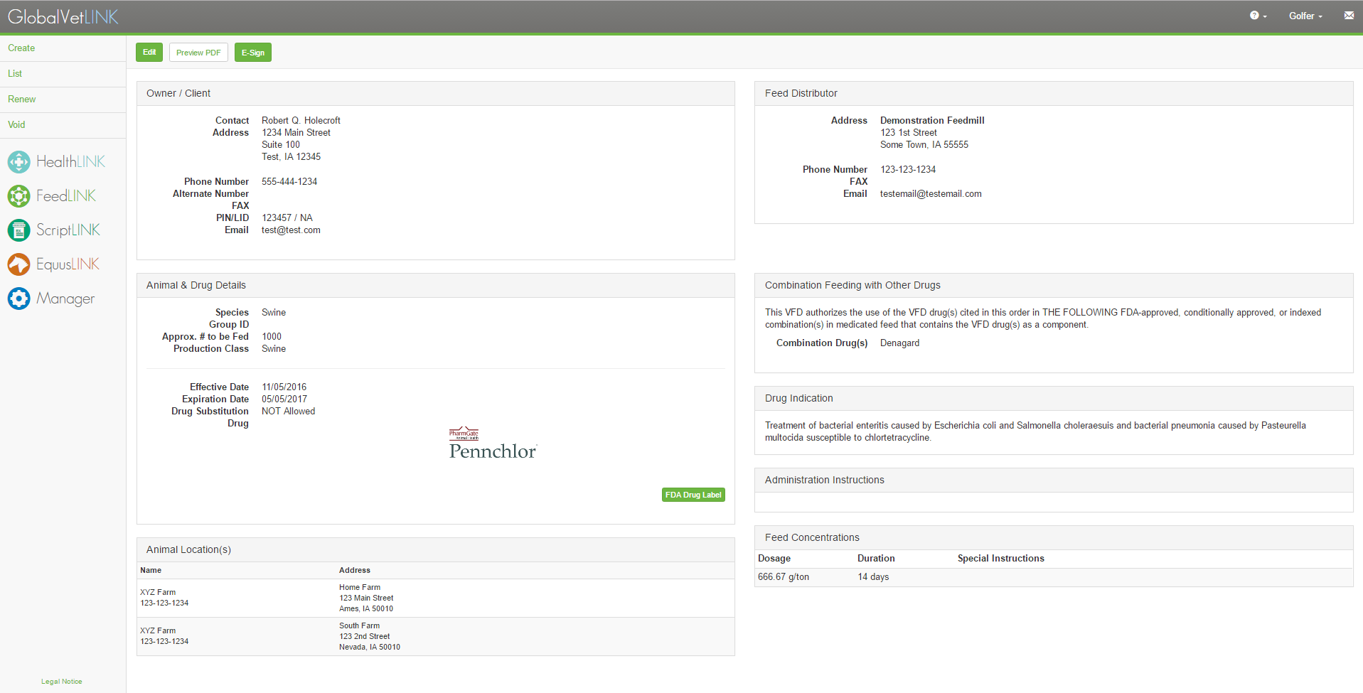
Preview VFD

Slide 26
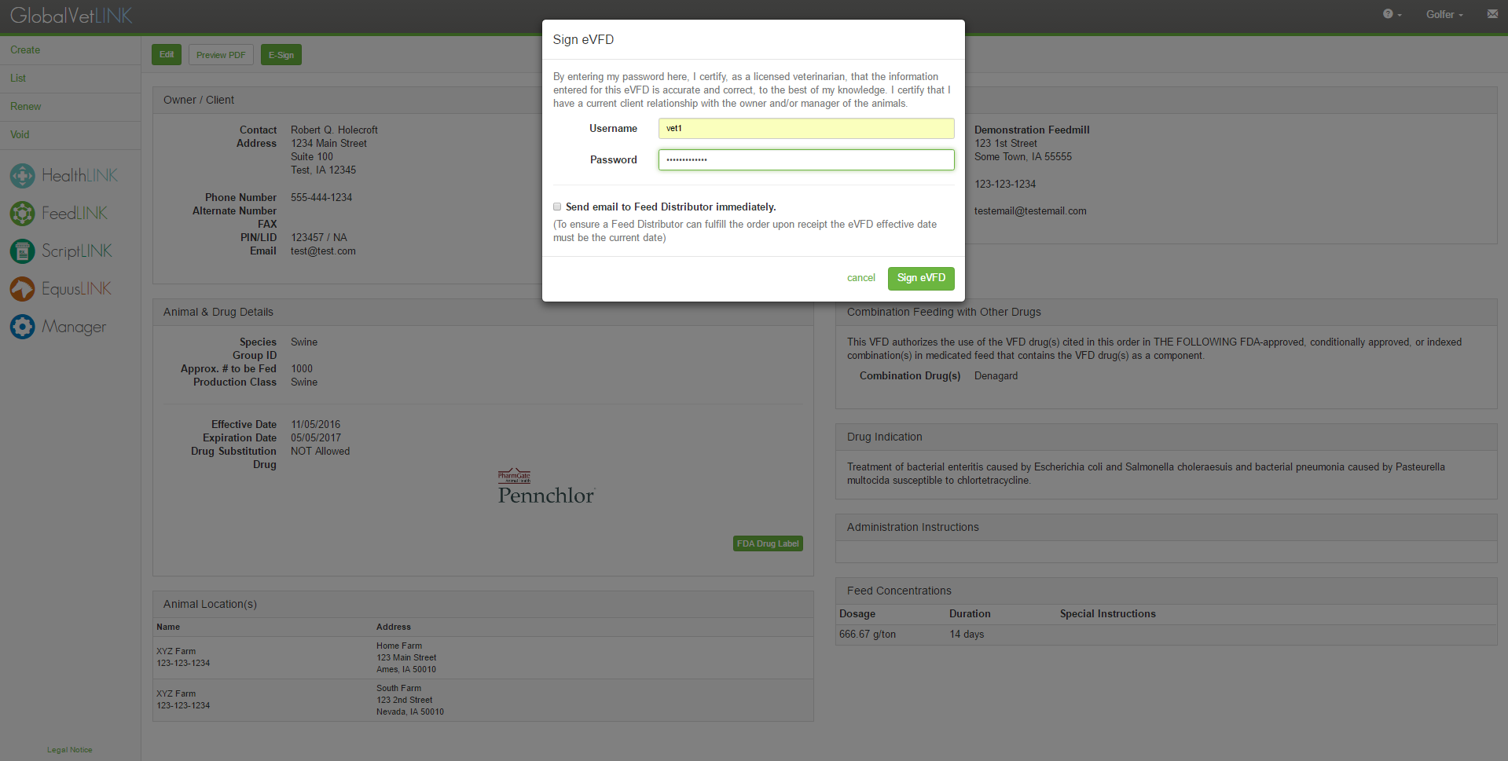
Sign VFD

Slide 27
Water Medications:
Medically Important
Antimicrobial Class | Specific drugs approved for use in water
Aminoglycosides | Apramycin, Gentamicin, Neomycin, Spectinomycin, Streptomycin
Lincosamides | Lincomycin
Macrolides | Carbomycin, Erythromycin, Tylosin, Aivlosin
Penicillins | Penicillin
Sulfas | Sulfachloropyrazine, Sulfachlorpyridazine, Sulfadimethoxine, Sulfamerazine, Sulfamethazine, Sulfaquinoxaline
Tetracycline | Chlortetracycline, Oxytetracycline, Tetracycline

Slide 28
Rx Requirements for the Veterinarian:
Issuing a Prescription:
Prescriber name, title, address and phone number
Date issued
Name and address of patient (ID of animal or herd/flock)
Drug name and strength
Quantity (numerically and alphabetically if controlled)
Directions for use – Be specific!
Number of refills
DEA # if controlled substance
Manual signature of prescriber

Slide 29
Labeling Requirements for Vets:
The label of drugs personally furnished to patients in Ohio must include:
Name and address of veterinarian
Name of client and identification of the animal(s) or group
Drug name and strength
Directions for use
Date dispensed
Any cautionary statements - withdrawals

Slide 30
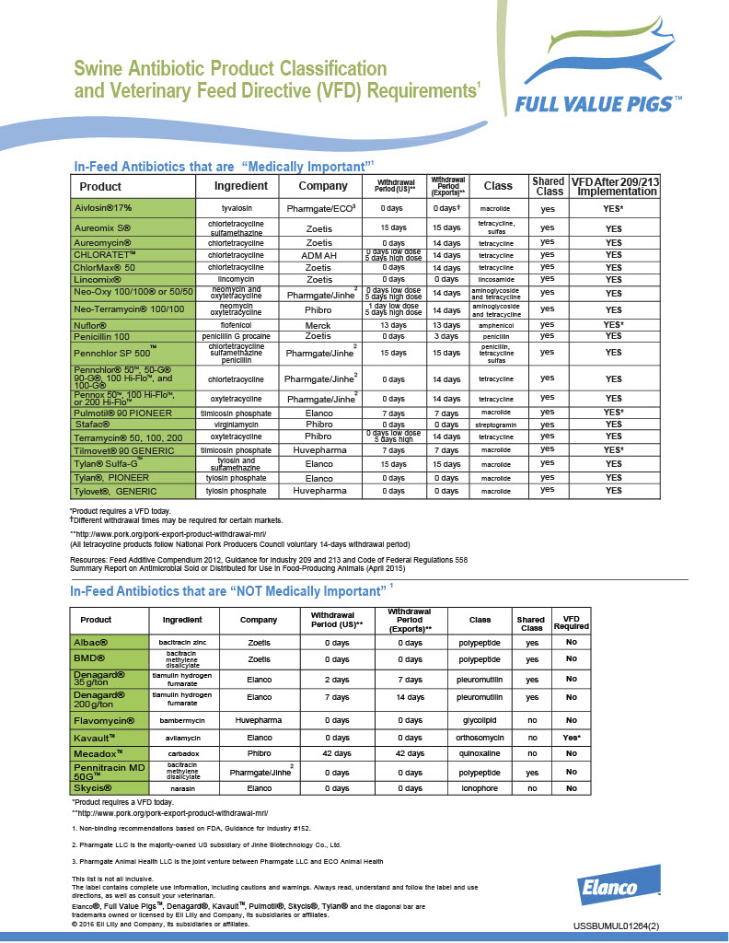

Slide 31
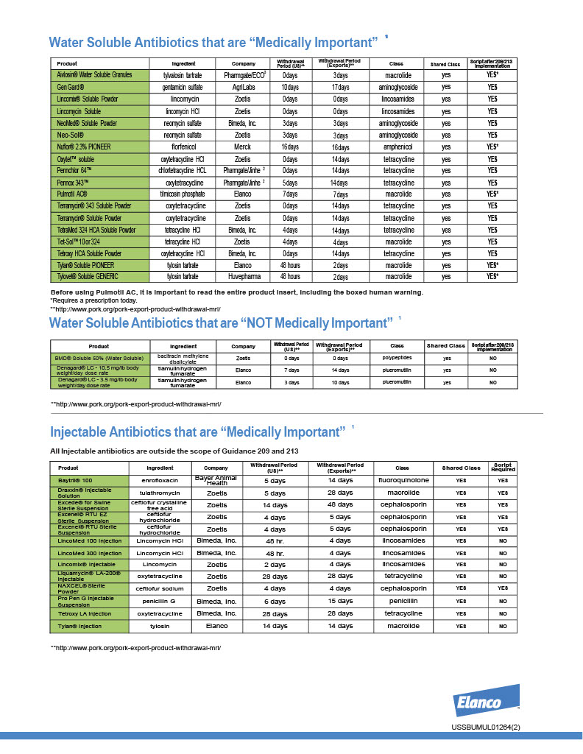

Slide 32
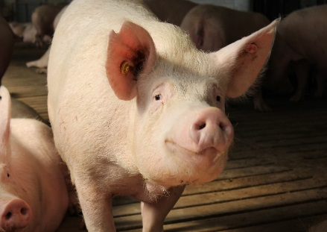



Thank You!
Many Thanks to our Sponsors……….

